Slide 1
A FIELD OVERVIEW, 2022–2026
HARNESS
Harness Engineering
Model
“Achieve better performance towards a goal”
How the layer around the model becomes a discipline
John Albert Jacob · Brownbag · October 2026
Notes:
Harness engineering is the practice of building everything around an AI model, such as tools, context, feedback loops and constraints, so an agent does reliable work. Plan: why it matters, what a harness is, how the idea developed from 2022 to 2026, the evidence, how teams apply it, and the open debates. Fill in the presenter name and event before presenting.
1

Slide 2



Agents now run for hours
6+
1M+
16
hours on a single Codex run
lines from Cursor's agents in about a week
Claude agents building one C compiler in parallel
Nobody can watch every step, so the environment has to catch the mistakes.
Sources: OpenAI (Feb 2026); Cursor (Jan 2026); Anthropic (Feb 2026)
05
Notes:
OpenAI's harness engineering report says single Codex runs regularly work on one task for upwards of six hours, often while the humans sleep, and calls human time and attention the one truly scarce resource. Cursor (Wilson Lin, Jan 2026): hundreds of concurrent agents wrote over 1M lines across 1,000 files in close to a week while building a web browser. Anthropic (Nicholas Carlini, 5 Feb 2026): 16 agents, nearly 2,000 Claude Code sessions and about $20,000 produced a 100,000-line Rust C compiler that builds Linux 6.9 on x86, ARM and RISC-V. Sources: openai.com/index/harness-engineering; cursor.com/blog/scaling-agents; anthropic.com/engineering/building-c-compiler.
5

Slide 3
What we'll cover
01
Why it matters
Same model, better results
02
What a harness is
The formula, its parts, and who owns which
03
How we got here
From prompts in 2022 to harnesses in 2026
04
What the evidence shows
Case studies from OpenAI and Anthropic
05
How teams build one
Guides, sensors and five habits
06
Where it's heading
The open debate and where teams are today
07
What it means for us
Do we need it, and do we build our own?
02
Notes:
Here's where we're going today. First, a quick look at why this matters at all: the same model can do a lot better or a lot worse depending on what you wrap around it. Then we'll pin down what a harness actually is, what's inside one, and which parts you control versus which parts your tool vendor controls. After that, a short history, from the prompt tricks of 2022 to the term "harness engineering" showing up this February. Then the evidence, mainly two case studies from OpenAI and Anthropic. Then the practical part: how teams actually build a harness. And we'll finish with the big open question, whether better models make all of this unnecessary, plus where teams are today. Then we'll close with two questions you're probably already asking: do we need to understand this, and do we need to build our own setup? And I'll leave you with a few things to try this week.
2

Slide 4
Same model, better agent
LangChain's coding agent on Terminal-Bench 2.0
Old harness
52.8%
New harness
66.5%
One model run through 8 harnesses on 25 tasks
Worst harness
68%
Best harness
88%
Only the harness changed.
Sources: LangChain (Feb 2026); Composio via Marmelab (Sept 2026)
03
Notes:
LangChain kept GPT-5.2-Codex fixed and changed only its harness (system prompt, tools and middleware such as a pre-completion checklist and loop detection). Its coding agent went from 52.8% to 66.5% on Terminal-Bench 2.0, from outside the top 30 to the top 5. A separate comparison by Composio ran the same model, provider and tools through 8 harnesses on 25 tasks; success ranged from 68% to 88%. Sources: langchain.com/blog/improving-deep-agents-with-harness-engineering (17 Feb 2026); marmelab.com/blog/2026/09/24/the-state-of-ai-harness-engineering-2026.html (citing Composio).
3

Slide 5



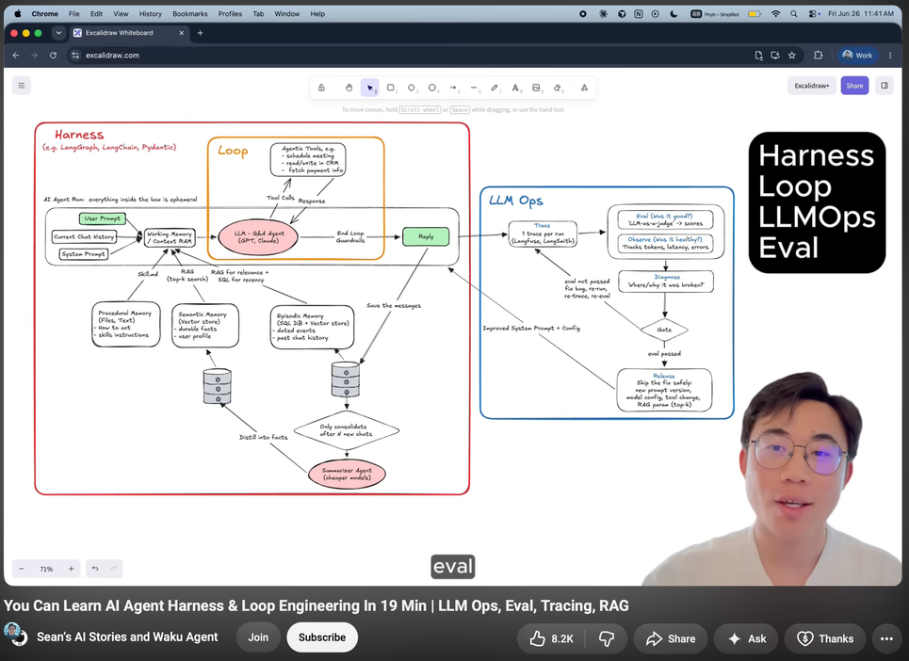
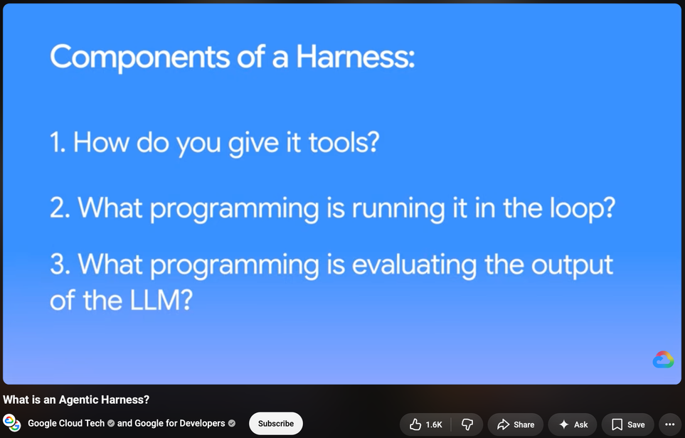
Agent = Model + Harness
+
=
Model
Harness
Agent
Source: LangChain, “The Anatomy of an Agent Harness” (Mar 2026)
04
Notes:
The formula comes from Vivek Trivedy at LangChain (10 Mar 2026): a harness is every piece of code, configuration and execution logic that isn't the model, including system prompts, tools, skills and MCP servers, a filesystem, sandbox and browser, orchestration, and hooks or middleware. The practice of harness engineering was named by Mitchell Hashimoto on 5 Feb 2026: whenever an agent makes a mistake, engineer a fix so it never makes that mistake again, either as a line in AGENTS.md or as a programmed tool. Six days later OpenAI used the term in a major report and it went mainstream. Sources: langchain.com/blog/the-anatomy-of-an-agent-harness; mitchellh.com/writing/my-ai-adoption-journey.
4

Slide 6
Four eras
2022–23
2024
2025
2026
Prompts and loops
Agent interfaces
Coding agents
Harness engineering
ReAct, AutoGPT, function calling
SWE-agent, Devin, MCP
Claude Code, Codex, AGENTS.md
Guides, sensors, automated harnesses
prompt engineering
scaffolding
context engineering
harness engineering
09
Notes:
2022 to 2023, prompts and loops: ReAct (Oct 2022) defined the reason, act, observe loop; AutoGPT (30 Mar 2023) and BabyAGI (early Apr 2023) were the first viral autonomous loops; OpenAI added function calling on 13 Jun 2023. 2024, agent interfaces: Devin launched 12 Mar 2024; SWE-agent (May 2024) showed a purpose-built agent-computer interface lifted SWE-bench to 12.5%; Anthropic released MCP on 25 Nov 2024. 2025, coding agents: Claude Code preview 24 Feb 2025; Codex CLI 16 Apr and Codex cloud 16 May 2025; AGENTS.md in Aug 2025; Agent Skills 16 Oct 2025; Anthropic's long-running harness 26 Nov 2025. 2026, harness engineering: Hashimoto 5 Feb, OpenAI 11 Feb, Böckeler's memo 17 Feb and full article 2 Apr, LangChain's anatomy 10 Mar, automated harness research such as Meta-Harness from Mar 2026. The italic line in each band is the term people used at the time.
9

Slide 7
Prompt, context, harness
Harness engineering
The whole system around the model
Context engineering
Everything the model sees each turn
Prompt engineering
The wording of one request
Sources: Cognition, Lütke, Karpathy (Jun 2025); Hashimoto, OpenAI (Feb 2026)
06
Notes:
Prompt engineering optimized the wording of a single request and went mainstream with ChatGPT in 2022 and 2023. Context engineering curates everything the model sees on each turn: Cognition's Walden Yan used the term on 12 Jun 2025, then Tobi Lütke and Andrej Karpathy popularized it later that month, and Anthropic published a guide in Sept 2025. Harness engineering covers the whole system around the model, including the loop, tools, environment, feedback and constraints; it was named in Feb 2026. Most writers treat these as nested layers, as drawn here, but Birgitta Böckeler treats user-side harness engineering as a specific form of context engineering, so the boundary is still debated.
6

Slide 8



Inside a harness
THE HARNESS
steer
Model
check
Guides
Sensors
acts with tools
Prompt, AGENTS.md, skills
Tests, linters, reviewers
feedback: fix and retry
Environment
tools · sandbox · permissions · memory files
When a mistake repeats, add a guide or a sensor*
Sources: Böckeler (Apr 2026); de Macedo (Jun 2026); LangChain (Mar 2026)
07
Notes:
Read it left to right as one cycle. Guides steer the model before it acts. The model acts with tools inside the environment. Sensors check the result, and their feedback goes straight back to the model so it can fix and retry; that loop is the agent loop. Everything in the white box is the harness. Sources: Sanderson de Macedo (arXiv 2606.10106, Jun 2026) defines a harness by four parts: an agent loop, a tool interface, context management and control mechanisms. Birgitta Böckeler (martinfowler.com, Apr 2026) splits the controls into guides (before) and sensors (after). LangChain (Mar 2026) lists the components: prompts, tools, skills, MCP servers, sandbox, orchestration and hooks.
7

Slide 9
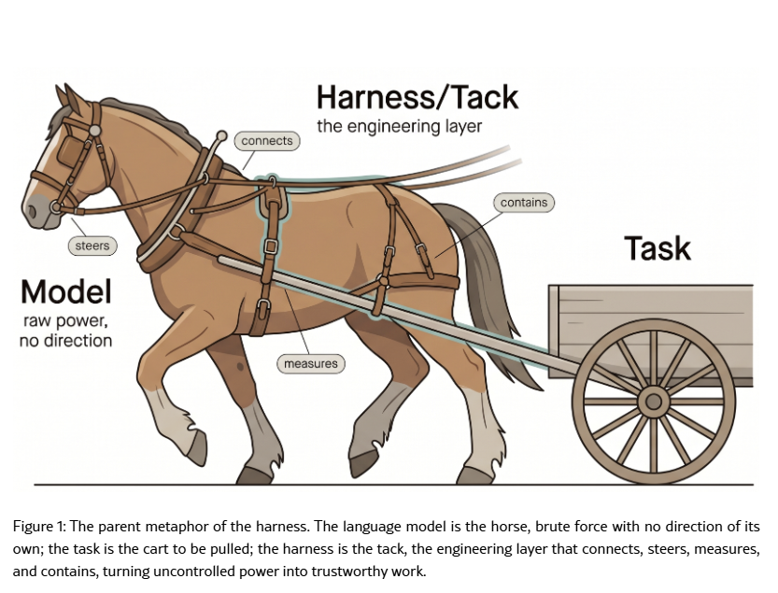
Harness in action
Figure 1. From “What makes a harness a harness: necessary and sufficient conditions for an agent harness”.
By Macedo, S. O. (2026). arXiv. https://arxiv.org/abs/2606.10106

Slide 10





Five instances when utilizing a harness
A map, not a manual
Enforce with code, not prose
Fast checks on every change
State in files and git
Build to delete
Evidence for each in the speaker notes · OpenAI, Marmelab, LangChain, Anthropic
14
Notes:
A map, not a manual: OpenAI replaced one big AGENTS.md with a roughly 100-line table of contents pointing into a docs/ folder. Enforce with code, not prose: a study of 481 public CLAUDE.md files (arXiv 2608.23550, as summarized by Marmelab, Sept 2026) found only 4.4% of written security rules were backed by an actual control. Fast checks on every change: LangChain's pre-completion checklist makes the agent run a verification pass before it may stop. State in files and git: Anthropic's long-running harness (Nov 2025) uses a feature list, a progress file and git commits so each new context can resume. Build to delete: Anthropic (Mar 2026) says every harness component encodes an assumption about what the model can't do, so re-test and remove pieces as models improve.
14

Slide 11
Will better models eat the harness?
YES, IT GETS ABSORBED
NO, IT KEEPS MOVING
Scaffolds get replaced as models improve.
Useful harnesses change shape rather than shrink.
Noam Brown, via Latent Space
Anthropic
So far, each model generation reshapes the harness rather than removing it.
Sources: Latent Space (Mar 2026); Anthropic (Mar 2026)
15
Notes:
The skeptic case: Noam Brown, quoted by Latent Space (5 Mar 2026), argued that just as reasoning models replaced the scaffolding built around earlier models, today's scaffolds will be replaced as models become more capable. Vercel (22 Dec 2025) likewise advised building for the model you'll have in six months. The counter case: Anthropic (24 Mar 2026) found that the space of interesting harness combinations moves rather than shrinks, and that better models leave room for harnesses that do more than the model can alone. Evidence: Opus 4.5 removed the need for context resets and Opus 4.6 made sprints unnecessary, but the planner and evaluator still added value. Related: Cognition argued against multi-agent systems in Jun 2025, then reported multi-agent deployments working in practice in Apr 2026.
15

Slide 12
Lots of instructions, little enforcement
Ship an agent instruction file
63%
of 145 large open-source projects
Declare a subagent
3%
of the same 145 projects
Commit a deny rule
3%
of 391 repositories
Have any tests or evals
40%
of 97 testable harnesses
Source: Marmelab audit of 246 harness repos and 145 large open-source projects (Sept 2026)
16
Notes:
Marmelab (François Zaninotto, 24 Sept 2026) audited 246 harness repositories and read 57 publications, with a counter-test of 145 large open-source projects. 63% of those 145 ship an agent instruction file, but only 4 (about 3%) declare a subagent. Only 12 of 391 repositories (about 3%) commit a single deny rule. Of 97 harnesses big enough to test, 60% have neither a test nor an eval, so only 40% have any. AGENTS.md is winning: 189 repos have one at the root versus 155 with CLAUDE.md. About a quarter of commits touching a harness are explicitly AI-signed. Note each bar has a different base, shown under its label. Source: marmelab.com/blog/2026/09/24/the-state-of-ai-harness-engineering-2026.html.
16

Slide 13
Must we build it on our own?
Not from scratch. Start with your tool's harness and add a thin layer.
Option 1
Option 2
Option 3
Use it as is
Add a thin layer
Build your own
OpenAI: ~1M agent-written lines. Anthropic: 6-hour, $200 runs.
Vendors ship the inner harness; users build the outer one around it
“The best agents might be the ones with the fewest tools.”
OpenAI, Feb 2026; Anthropic, Mar 2026
Birgitta Böckeler, Apr 2026
Andrew Qu, Vercel, Dec 2025
Grow it one fix at a time. Each piece “encodes an assumption about what the model can't do on its own”: add it when needed, delete it when not. · Prithvi Rajasekaran, Anthropic
Sources: martinfowler.com (Apr 2026); Vercel (Dec 2025); OpenAI (Feb 2026); Anthropic (Mar 2026)
19
Notes:
Second question: do we have to build our own setup to keep up? Not from scratch, and here's what the people who've done it say. Step one, use your tool as it comes. Birgitta Böckeler at Thoughtworks describes it as two layers: the vendor ships the inner harness inside Claude Code, Codex or Cursor, and we users build the outer one around our own codebase. Step two is where I'd start, and it's small: a short AGENTS.md, your existing tests and linters wired in as checks, and a few skills. Keep it lean. Vercel removed most of their agent's tools and it got better; as Andrew Qu wrote, "the best agents might be the ones with the fewest tools." Step three, a full harness of your own, is what OpenAI and Anthropic did for an agent-built product with about a million lines, and for unattended six-hour, two-hundred-dollar runs. Most of us won't need that. Finally, grow it one fix at a time. Prithvi Rajasekaran at Anthropic points out that every harness piece "encodes an assumption about what the model can't do on its own," so add pieces when the agent keeps failing, and remove them when a new model no longer needs them. Sources: martinfowler.com/articles/harness-engineering.html; vercel.com/blog/we-removed-80-percent-of-our-agents-tools; openai.com/index/harness-engineering; anthropic.com/engineering/harness-design-long-running-apps.
19

Slide 14



Do you need to learn Harness Engineering
Yes, enough to steer one. Not to build one from scratch.
“Humans steer. Agents execute.” · Ryan Lopopolo, OpenAI
It changes results as much as the model
You already have one
It tells you what to fix
Same model, only the harness changed: 52.8% to 66.5% on Terminal-Bench 2.0
“…engineer a solution such that the agent never makes that mistake again.”
“If you're not the model, you're the harness.”
LangChain, Feb 2026
Vivek Trivedy, LangChain, Mar 2026
Mitchell Hashimoto, Feb 2026
Sources: OpenAI, “Harness engineering” (Feb 2026); LangChain (Feb, Mar 2026); mitchellh.com (Feb 2026)
18
Notes:
So, two questions I'd expect from this room. First: do we actually need to understand any of this? I'd say yes, but only enough to steer it. The OpenAI team that built a million lines with agents summed up their job in four words: "Humans steer. Agents execute." Three reasons it's worth knowing. One, the harness moves results about as much as picking a better model. LangChain kept the same model and went from 52.8 to 66.5 percent on Terminal-Bench 2.0 just by changing the harness. Two, you already have one. Vivek Trivedy at LangChain put it simply: "If you're not the model, you're the harness." Every AGENTS.md line you write is harness. Three, it tells you what to fix. Mitchell Hashimoto's rule is that whenever an agent makes a mistake, you "engineer a solution such that the agent never makes that mistake again." Sources: openai.com/index/harness-engineering; langchain.com/blog/improving-deep-agents-with-harness-engineering; langchain.com/blog/the-anatomy-of-an-agent-harness; mitchellh.com/writing/my-ai-adoption-journey.
18

Slide 15

For more in-depth illustrations and discussions
Harness engineering for coding agent users
Horse-and-tack metaphor, Fig. 1
Birgitta Böckeler, martinfowler.com, Apr 2026
Sanderson de Macedo, arXiv 2606.10106, Jun 2026
Open the article
Open the paper
Anatomy of an agent harness, Fig. 3
The browser Cursor's agents built
Sanderson de Macedo, arXiv 2606.10106, Jun 2026
Cursor, “Scaling long-running autonomous coding”, Jan 2026
Open the paper
Open the post
17
Notes:
Use this slide as a pointer during Q&A or as a backup. Böckeler's article opens with an overview diagram of a coding-agent harness: guides on one side (principles, rules, reference docs, how-tos, language servers, CLIs, scripts, codemods) and sensors on the other (review agents, static analysis, logs, browser). De Macedo's paper has five figures; Fig. 1 shows the model as a horse and the harness as the tack that channels its power, and Fig. 3 maps the components around the model (tool registry, context manager, memory, agent loop, verifier, retry, observability, guardrails, deterministic handlers). Cursor's post includes a screenshot of the web browser its agents built from scratch. If you want any of these on a slide, take the screenshot yourself, add a credit line and check the author's reuse terms.
17

Slide 16


Start your harness this week
Log every mistake you fix by hand
Turn repeats into guides or sensors
Keep AGENTS.md short
Re-test at every model upgrade
Agent = Model + Harness. You build the harness.
Notes:
Close on actions the audience can take this week. The first two are Hashimoto's habit and Böckeler's steering loop: every time you correct an agent, ask whether a guide (an instruction, a skill, a doc) or a sensor (a test, a linter, a hook) would have caught it, and add one. Keeping AGENTS.md short is OpenAI's lesson: a map that points into deeper docs. Re-testing at every model upgrade is Anthropic's: every component encodes an assumption about the model, so strip what is no longer load-bearing. Invite questions.
20

Slide 17
End of Presentation
Notes:
Close on actions the audience can take this week. The first two are Hashimoto's habit and Böckeler's steering loop: every time you correct an agent, ask whether a guide (an instruction, a skill, a doc) or a sensor (a test, a linter, a hook) would have caught it, and add one. Keeping AGENTS.md short is OpenAI's lesson: a map that points into deeper docs. Re-testing at every model upgrade is Anthropic's: every component encodes an assumption about the model, so strip what is no longer load-bearing. Invite questions.
20

